Slide 1
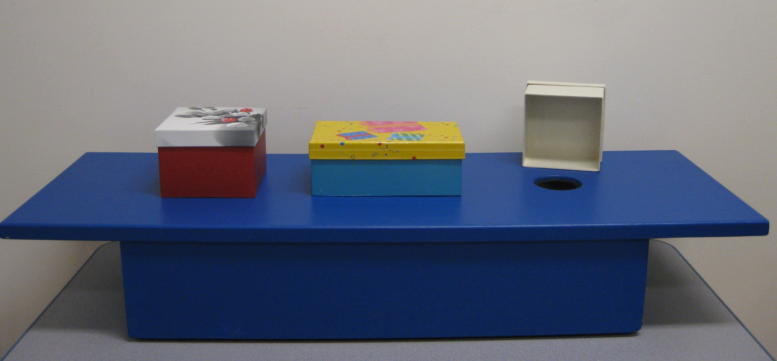
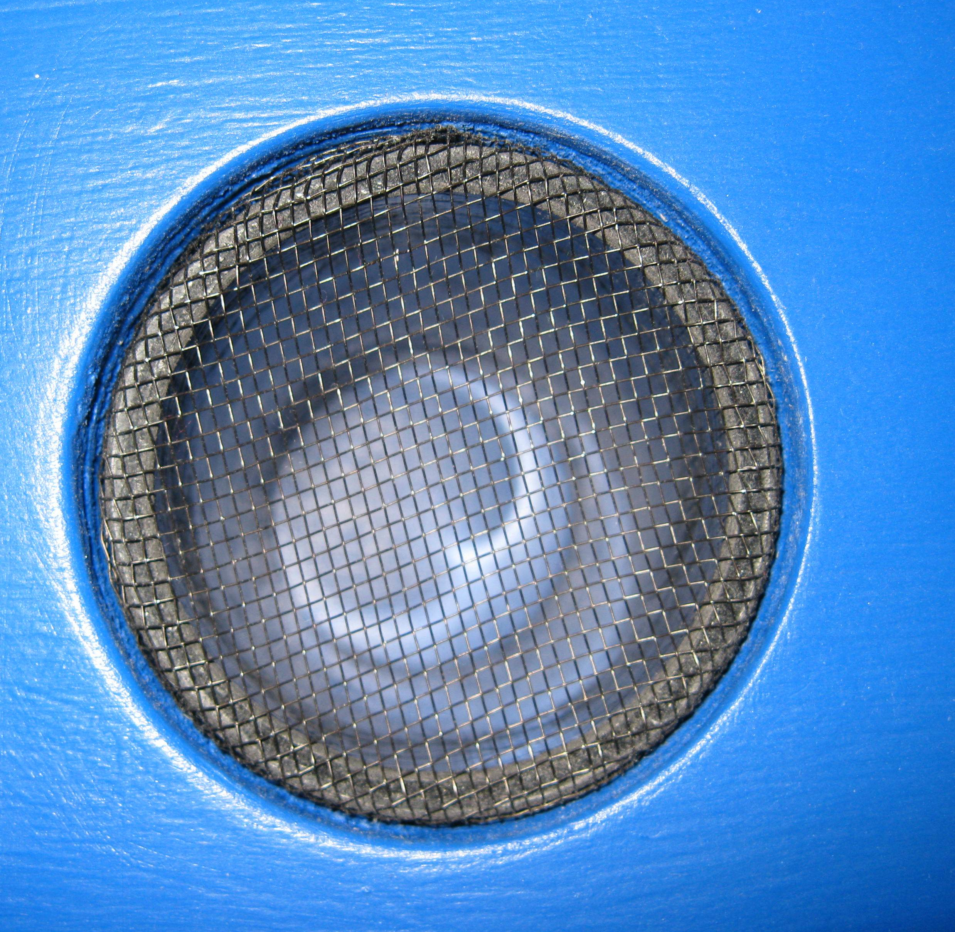
Figure 1. Apparatus used in the what-where-how long task. The photo depicts (a) the three cardboard boxes and the wooden platform and (b) a detail of one of three holes and plastic netting
(a)
(b)

